Slide 1

Amazon Revenue Optimization
Optimize the
Revenue
of Amazon!
By Danyang He
Danyang He

Slide 2
Outlier
Outlier
Importance of the project
Set up the prediction model
Impact of the model
Recommendation

Slide 3
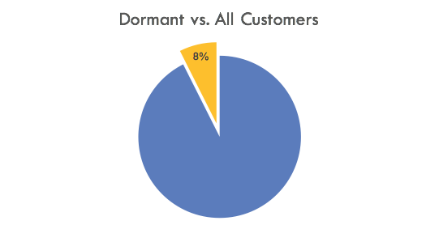
Dormant Customers are Important!
They are Important
5 millions customers
400k dormant customers for 3 months
Customer churn
Big loss in the revenue

Slide 4

Why they Disappear
Why they disappear
Bad customer service
Products they bought can be used for a long term
Price is not competitive
The design of website is complicate
Customers went out for a travel

Slide 5
Why not target new customers
Compared to new customers
Acquiring a new consumer can cost 6-7 times than retaining an existing one.
$$$
$$$
$
Acquire a new one
Retain an existing one

Slide 6
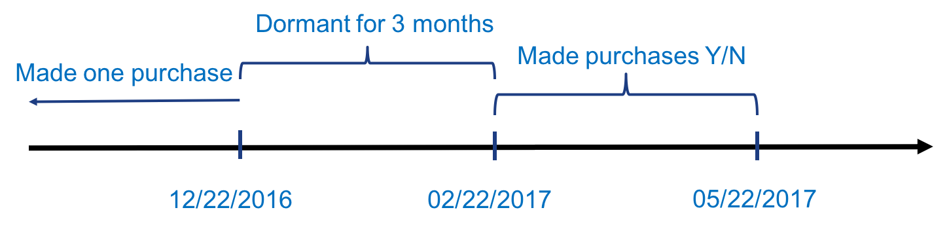
Predict the Potential Customers
Define potential customers
If Yes, flag 1 (48,553 customers)
Else flag 0 (367,466 customers)
Proportion: 1/(0+1) = 11%
Is_converted model

Slide 7
Why Use 3-Month Dormant Period
3-month
Avg. spend
(in 3 months)
Average spend decreases when days_difference increases
Average spend do not change after 90 days differences.
1
90
150
Days_difference

Slide 8
Train the Model
Train the model
Lasso Logistic Regression
Ridge Logistic Regression
Random Forest

Slide 9
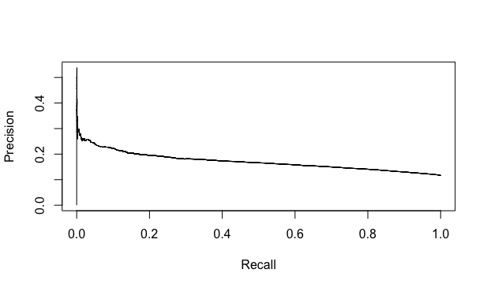
Accuracy is Improved
Evaluate the model
Precision-recall Curve
- Recall = 0.2, Precision = 0.2
- 163,846 customers: flag 0
- 19,480 customers: flag 1
Random guess: 0.1
Precision is twice increased

Slide 10

Optimize our Revenue
Recommendations
Focus on the potential customers
- Provide promotions
- Send email to notify
Pay more attention on “top” countries
- United States
- Germany
- Japan
Improve customer service
Simplify the website

Slide 11

THANK YOU!
Questions?
THANK YOU!
Question?

